Slide 1


DIE FALLE DES FALSCHEN SICHERHEITSGEFÜHLS
DIE FALLE DES FALSCHEN SICHERHEITSGEFÜHLS
WIE SICH ENTWICKLER SICHER SICHER FÜHLEN

Slide 2

WE HAVE LIMITED SPACE FOR OUR WORKING MEMORY, AND USING IT UP FOR ANYTHING A COMPUTER CAN DO FOR US IS COUNTER-PRODUCTIVE.
WE HAVE LIMITED SPACE FOR OUR WORKING MEMORY, AND USING IT UP FOR ANYTHING A COMPUTER CAN DO FOR US IS COUNTER-PRODUCTIVE.
– Chris Allen

Slide 3
category theory
monads
applicatives
functors
DSLs
property-based testing
currying
functional programming
dependency rejection
reactive programming
mappables
identity
type-drive development
hole-driven development
type-level programming
elm
haskell

Slide 4

Entwicklungsprozess/Team/Mindset
Workation
Meetings
Teamstruktur/heterogenes Team
Jira/Confluence
viel Zeit

Slide 5

Git/Continuous Integration/Code Reviews
Jenkins
GitHub

Slide 6

Safety through Types
nlkl/Optional
OneOf
ValueOf
Domain Modeling
Union Types/Sum Types
Why Exceptions are not the answer to everything, vs. Errors

Slide 7

Loops vs. FP Array Functions
https://fsharpforfunandprofit.com/posts/expressions-vs-statements/

Slide 8

IF Statements vs. Expressions
https://fsharpforfunandprofit.com/posts/expressions-vs-statements/
https://medium.com/javascript-scene/nested-ternaries-are-great-361bddd0f340

Slide 9

Pure/One-Line Functions

Slide 10
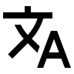
DSLs
C# Time
https://stackoverflow.com/questions/17224090/how-can-i-write-a-fluent-datetime-value#comment24953860_17224151
https://github.com/softawaregmbh/library-holidays/blob/experiments/softaware.Holidays.Core.Tests/Tests.cs
Elm HTML
Elm/Typescript CSS
Verbal Expressions
…

Slide 11

Dev-Tools
tslint/dotnet Analyzers/StyleCop
prettier, go-fmt, elm-fmt (git diff)
git hooks
Visual Studio Live Unit Testing
Notes:
[Fact]
public void TestUnixInitialDate()
{
Assert.Equal(new DateTime(1970, 1, 1), this.dateGenerator.UnixInitial());
}

Slide 12
Outlook: The Compiler as Your Friend (Idris, Liquid Haskell, …)

Slide 14
hey there... 😉
I have to start with a small sorry upfront for showing you the following 🙈
... but I told myself I have to present this at every java…script-meetup I talk at 🙃
Notes:
[2 min]
- COMIC (alt-tab, make sure photos app is started!)

Slide 15
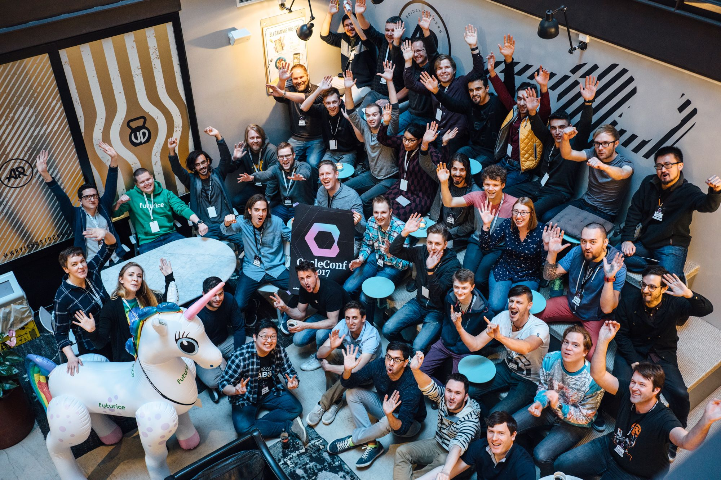

CycleConf 2017
Cycle.js
Notes:
[30 sec]
End of April in Stockholm organized by Futurice
~ 50 people
Liked the idea, no experience

Slide 16
Cycle.js

Slide 17
idea
concept
motivation
Notes:
[1 min]
- “The guy who created this, likes to think a lot – very philosophical questions”

Slide 18
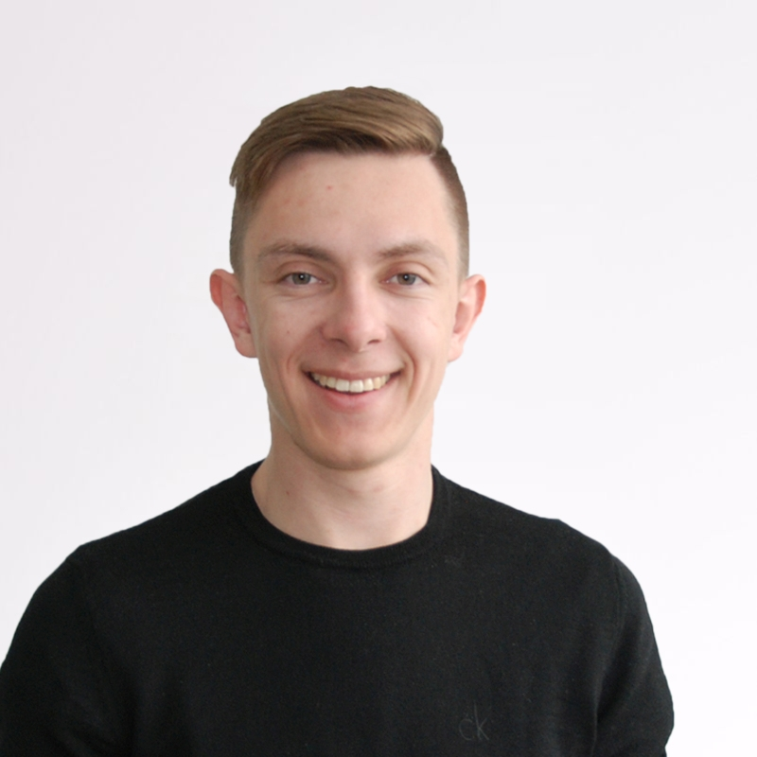


studying psychology @ university of innsbruck
studied software engineering @ fh hagenberg
working @ softaware gmbh
Bernhard Mayr
#types #docker #typescript #ux #types #windows #continousintegration #dotnetcore #types #graphs #dx #types #xplatform #azure #angular #types #haskell #idris #purescript #statecharts #reactivity #typestyle #droneio #types #continuousdeployment
/
bemayr
Notes:
[30 sec]

Slide 19
professional overthinker with severe OCD
part time psychology student
full time “siach”
Bernhard Mayr
#types #docker #typescript #ux #types #windows #continousintegration #dotnetcore #types #graphs #dx #types #xplatform #azure #angular #types #haskell #idris #purescript #statecharts #reactivity #typestyle #droneio #types #continuousdeployment
/
bemayr
Notes:
[30 sec]

Slide 20
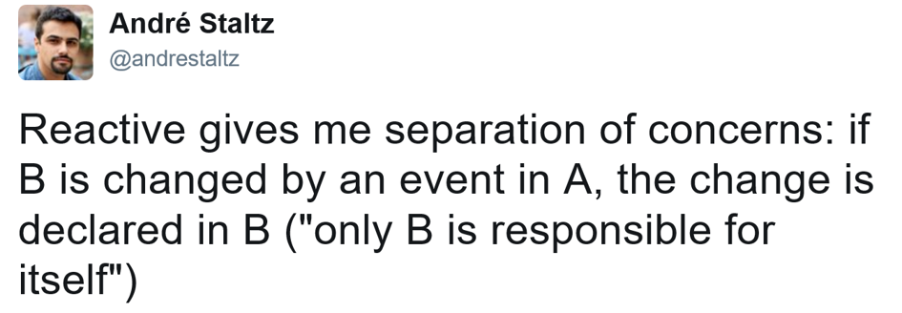
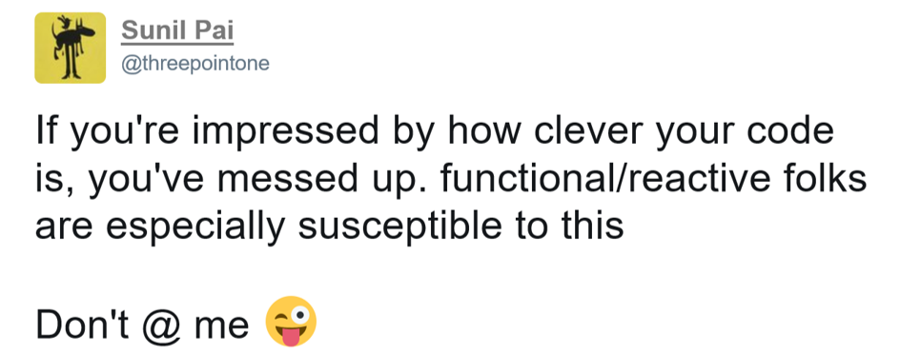

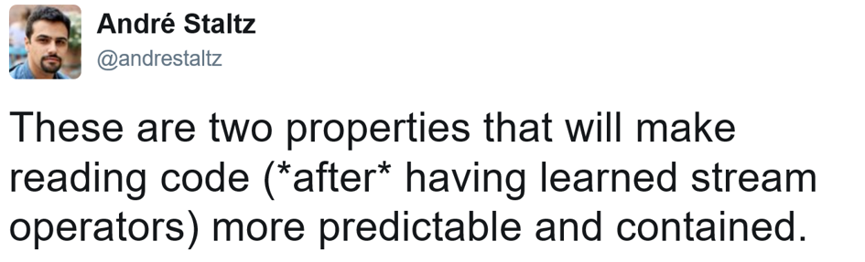
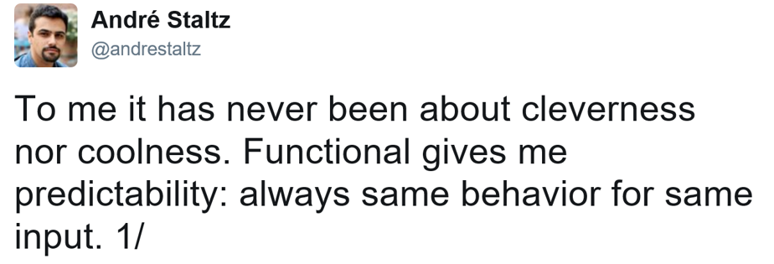

Slide 21
FUNCTIONAL
purity
Notes:
[1 min]
- “The guy who created this, likes to think a lot – very philosophical questions”

Slide 22
Pure Functions no side effects
// === PURE === //
Math.max(...values: number[]);
const double = x => x * 2;
// === IMPURE === //
Math.random()
function addToCart(item): void { cart.add(item); }
// - same input => same output
// - produce no side effects
// - does not rely on external mutable state

Slide 23
FUNCTIONAL
purity
declarative
Notes:
[1 min]
- “The guy who created this, likes to think a lot – very philosophical questions”

Slide 24
declarative “What” not “how”
const frameworks = ["React", "Cycle", "Covfefe"];
console.log(jsFrameworks); // ["React.js", "Cycle.js", "Covfefe.js"]
// not functional (imperative - you have to specify everything) let jsFrameworks = []; for (let i = 0; i < frameworks.length; i++) { jsFrameworks[i] = `${frameworks[i]}.js`; }
// functional (declarative - specify what, not how) const jsFrameworks = frameworks.map(framework => `${framework}.js`);

Slide 25


Slide 26
REACTIVE
Inversion of Control
Notes:
[1 min]
- “The guy who created this, likes to think a lot – very philosophical questions”

Slide 27
Inversion of Control
function onNetworkRequest() {
// ...
Bar.incrementCounter();
// ...
}
Foo.addOnNetworkRequestListener(() => {
self.incrementCounter(); // self is Bar
});
proactive
passive
listenable
reactive
POTUS
Twitter
POTUS
Twitter
POTUS
Twitter
preventBullshit();
POTUS.addOnGreatGreatMessageListener(() => {
self.
});
function onGreatGreatMessage() {
// ...
Twitter.tweet("covfefe");
// ...
}
POTUS.addOnGreatGreatMessageListener(() => {
self.tweet("covfefe"); // self is Twitter
});
Twitter gets reactive
tweet(…) can be private now
Logic is defined solely in Twitter
Notes:
no state management exposed

Slide 28
REACTIVE
Inversion of Control
Streams/Observables (DEMO)
Notes:
[1 min]
- “The guy who created this, likes to think a lot – very philosophical questions”

Slide 29
{ }

Slide 30






Slide 31
A functional and reactive JavaScript framework for predictable code
Notes:
[1 min]
- “The guy who created this, likes to think a lot – very philosophical questions”

Slide 32
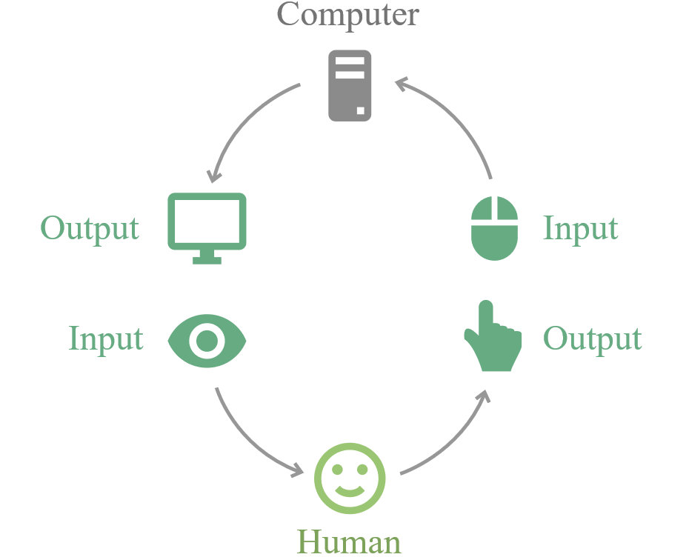
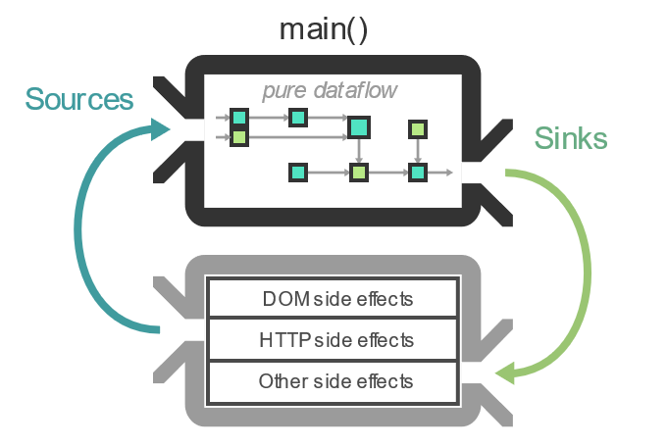
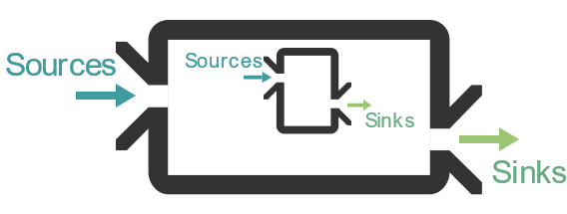
Name
architecture
components

Slide 33
In many frameworks the flow of data is implicit: you need to build a mental model of how data moves around in your app.
In Cycle.js, the flow of data is [more or less] clear by reading your code.

Slide 34
{ }

Slide 35
😍
https://github.com/sartaj/pipe-me
https://github.com/cyclejs/time
https://github.com/cyclejs-community/awesome-cyclejs

Slide 36
sources
The introduction to Reactive Programming you've been missing
Reactive MVC and the Virtual DOM
cycle.js.org
CycleConf [talks]
Learning how to ride: an introduction to Cycle.js
Save time avoiding common mistakes using RxJS [big recommendation]

